Slide 1
Linear Regression
Presented By: Deepankar Sharma

Slide 2
Regression
Regression is used to study the relationship between two variables.
We can use simple regression if both the dependent variable (DV) and the independent variable (IV) are numerical.
If the DV is numerical but the IV is categorical, it is best to use ANOVA.

Slide 3
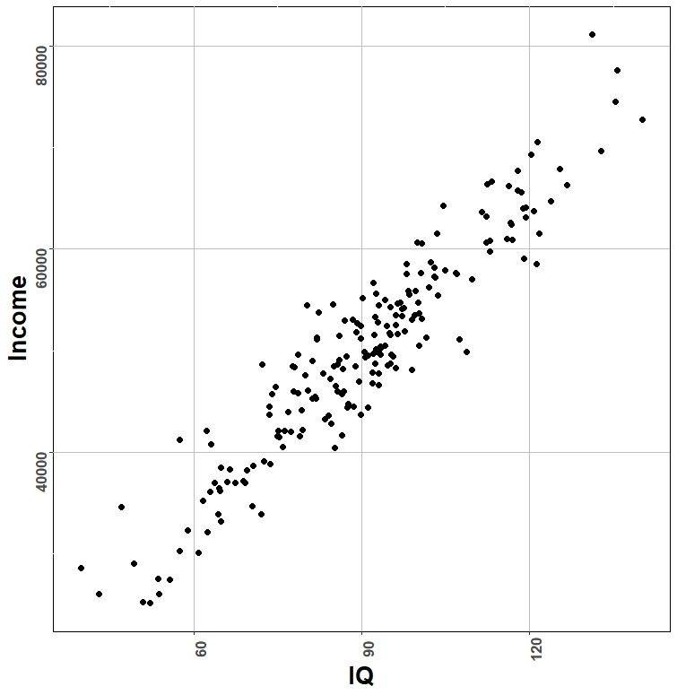
Displaying the data
When both the DV and IV are numerical, we can represent data in the form of a scatterplot.
It is important to perform a scatterplot because it helps us to see if the relationship is linear.

Slide 4
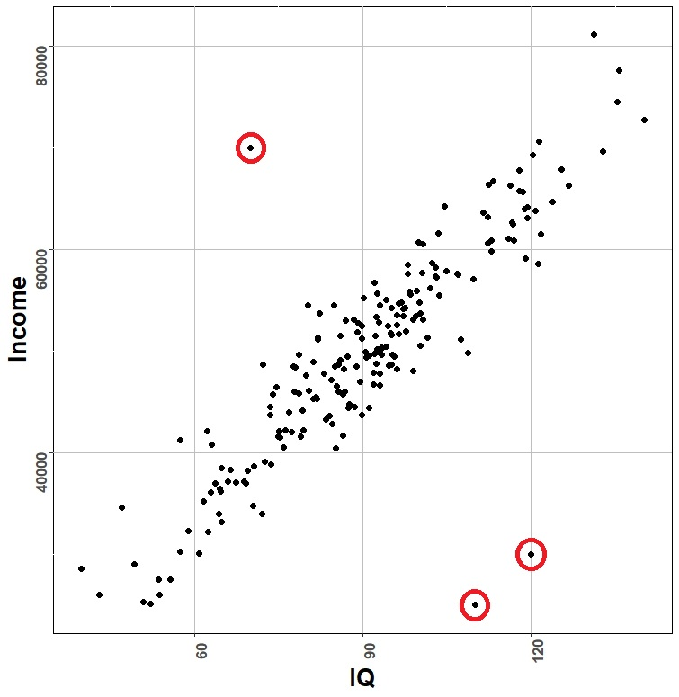
Assumptions of regression
There are no clear outliers
This can be checked by performing the scatterplot. The outliers (circled in red in the figure) can simply be removed from the analysis .

Slide 5
What is “Linear”?
Remember this:
Y=mX+B?
m
B

Slide 6
Predicted value for an individual…
y_{i}= α + β*x_{i} + random error_{i}
Fixed – exactly on the line
Follows a normal distribution

Slide 7
Linear model
In regression, the relationship between Y and X is modelled in the following form: Y = a + b * X + E, where:
Y is the dependent variable (Income in the example)
X is the independent variable (IQ in the example)
a is an intercept
b is the coefficient
E is an error term for each observation (since there is additional variation not explained by income)

Slide 8
Hypothesis testing
Regression tests the null hypothesis:
H₀ : There is no effect of X on Y, that is, b = 0.
versus the alternative hypothesis:
H₁ : There is an effect of X on Y, that is, b is not 0.
If the null hypothesis is rejected, we reject the hypothesis that there is no relationship and hence we conclude that there is a significant relationship between X and Y.

Slide 9
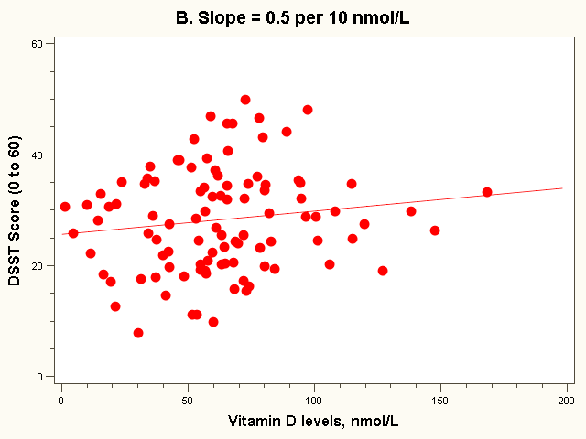
The “Best fit” line
Note how the line is a little deceptive; it draws your eye, making the relationship appear stronger than it really is!
Regression equation:
E(Y_{i}) = 26 + 0.5*vit D_{i} (in 10 nmol/L)

Slide 10
THANK YOU

